Slide 1
Week 1
The Basics, and beyond!

Slide 2

Who needs this information?

Slide 3
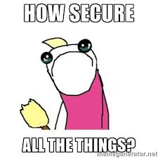
Why are we here?

Slide 4
Corporate vs Personal Security
The Basics
Corporate
  Company Security teams
  Larger target
  More weaknesses
Personal
  How to not get hacked (a.k.a don’t be pwned)

Slide 5
Activity!
https://haveibeenpwned.com/

Slide 6
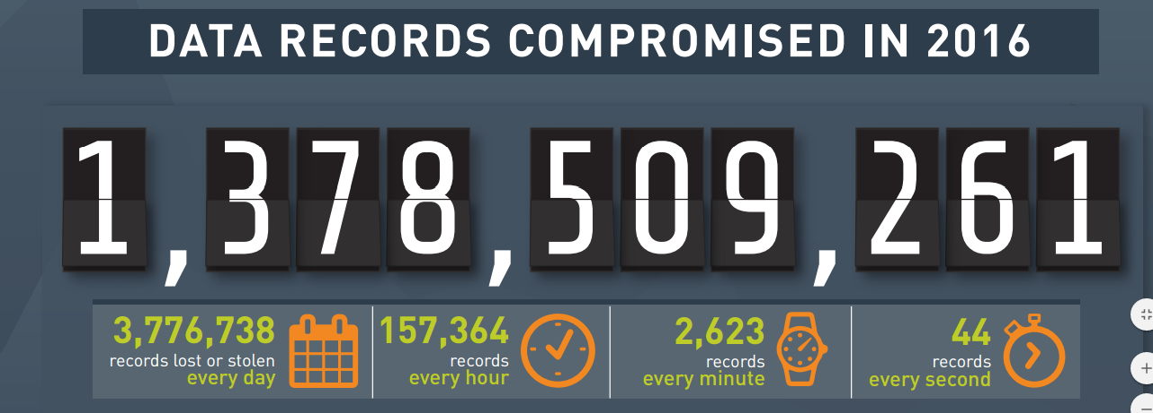
Am I alone in the pwnage?
http://www.informationisbeautiful.net/visualizations/worlds-biggest-data-breaches-hacks/
https://blog.gemalto.com/security/2017/03/29/2016-data-breach-trends-hackers-mine-large-databases-personal-gain/

Slide 7
Recent Breaches (2026)
Canvas (Instructure): data on over 30 million students and staff stolen after voice phishing
DentaQuest: health data of 15 million people, the largest known breach of 2026
  Source: TechCrunch, the worst hacks of 2026

Slide 8
But, Why did the Pwn happen?
Your password probably sucks
    Hey! It doesn’t suck, I use the same awesome password everywhere ← NO
    Hey! It doesn’t suck, QWERTY is sooo easy to remember ← NO
    Hey! My dog/mother/friends name is an awesome password ← NO
You don’t have/use two factor authentication
You tell the truth on the security questions when you register for sites

Slide 9

Am sad over pwnage, how fix?
https://krebsonsecurity.com/password-dos-and-donts/
https://www.wired.com/2016/05/password-tips-experts/
https://www.askideas.com/31-most-funny-sad-pictures-and-photos/

Slide 10
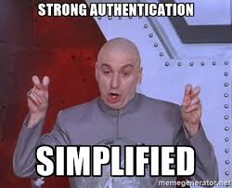
Authentication
Factors
  Know
  Have
  Are
Two-Factor

Slide 11
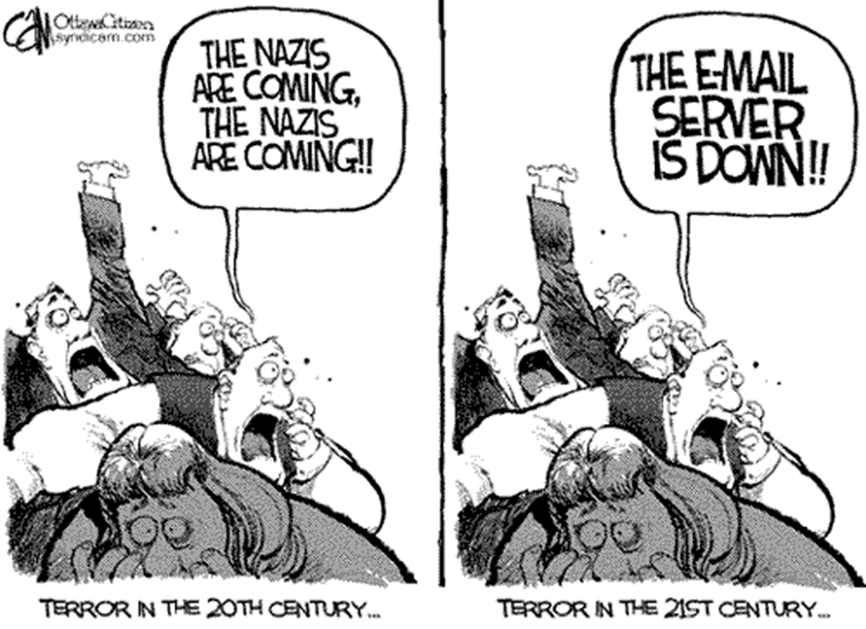
Email Server is down

Slide 12
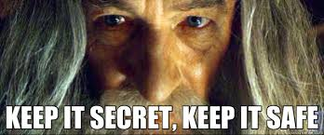
Confidentiality

Slide 13
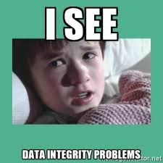
Integrity

Slide 14
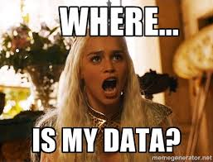
Availability

Slide 15
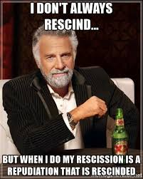
Repudiation

Slide 16
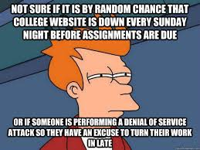
Denial Of Service
DOS
DDOS
DDOS vs Viral
Current Examples
  Dyn
  Mirai

Slide 17
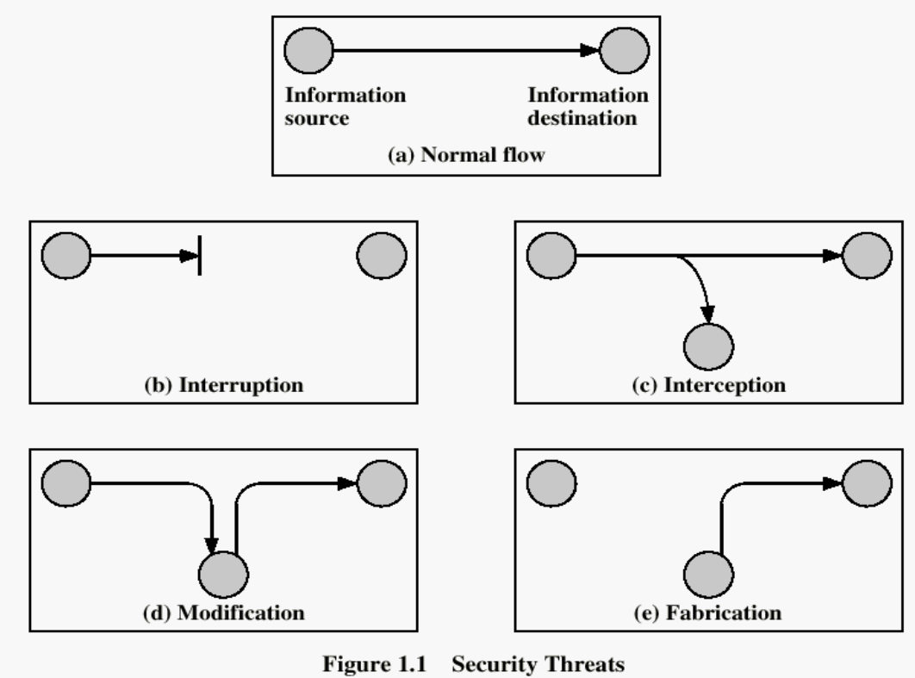
Communication Attack

Slide 18
Policy vs Mechanism
Security Policy
  What is and is not allowed
  Only the admin shall change passwords
Security mechanism
  How to enforce the policy
  Password file is encrypted and authenticates admin, keeps a log of all retrieval attempts.

Slide 19
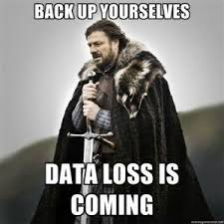
Mechanisms
Prevention
Detection
Recovery
IDS
IPS

Slide 20
Example
Prevention
  Locks and bars on house
Detection
  Stolen items are…..stolen
Recovery
  Call police, make insurance claim and replace items

Slide 21
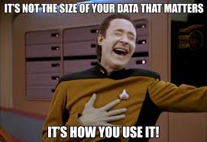
Data Handling
Data type
Media type
Responsibility (Who’s fault is it?)
  Breaking data into pieces
How long to keep it
Backups
  Need all the same questions answered
Electronic vs IRL data
Data integrity

Slide 22
PII in Massachusetts
Personal information - a combination of a name along with a Social Security number, bank account number, or credit card number
Encrypted when stored on portable devices, or transmitted wirelessly or on public networks.
Regulations call on businesses to utilize up-to-date firewall protection that creates an electronic gatekeeper between the data and the outside world and only permits authorized users to access or transmit data, according to preset rules.
http://www.mass.gov/ago/doing-business-in-massachusetts/privacy-and-data-security/standards-for-the-protection-of-personal.html

Slide 23
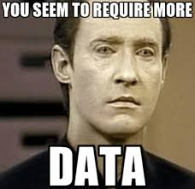
Data set value
Credit cards
Social Security Numbers
Email address
Physical addresses
Social media accounts
Bank Accounts

Slide 24
Example of Value Brazilian Underground
BRAZILIAN UNDERGROUND
  Set of business application account credentials US$155–193
  Set of credit card credentials US$35–135
  Set of online service account credentials US$19
  List of mobile phone numbers US$290–1,236
  List of landline phone numbers US$317–1,931
  https://www.trendmicro.com/vinfo/us/security/special-report/cybercriminal-underground-economy-series/global-black-market-for-stolen-data/

Slide 25
Example of Value
Visa or MasterCard credentials | $7
Credit card with magnetic stripe or chip data | $15
Premium American Express, Discover Card, MasterCard or Visa with strip or chip data | $30
Bank account credentials (balance of $15,000) | $500
Bank account credentials (balance of $70,000 to $150,000) | 6% of account balance
Large U.S. airline points accounts | 1.5 million points cost $450
Large international hotel chain points account | 1 million points cost $200
http://www.bankrate.com/financing/credit-cards/prices-rise-for-your-data-on-the-black-market/

Slide 26
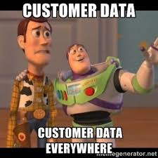
Data set risks
Hackers
  Equation Group (NSA)
PEBKAC
Apathy from consumers
Government infrastructure
  Equifax
  IRS
  Georgia secretary of state office
  Office of Personnel Management (OPM)
  USPS
Insider theft
  Edward Snowden Data Leaks

